Slide 1
Performance Testing
The Why, the What and the How
CS423 - 22APCS - Group 06:
Le Thanh Lam - 22125046
Nguyen Hoang Phuc - 22125076
Nguyen Chinh Thong - 22125102
Nguyen Vo Hoang Thong - 22125103

Slide 2
01
The Why
Performance has always been a big problem…

Slide 3
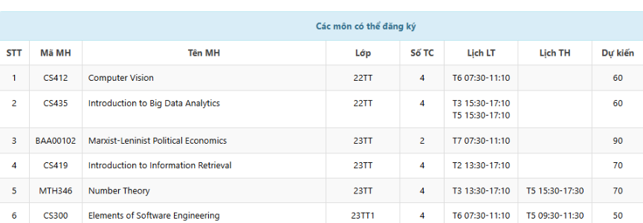

Slide 4
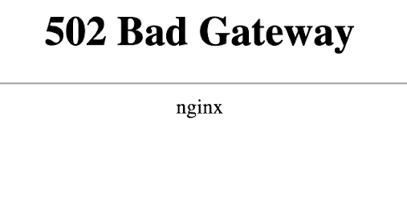

Slide 5
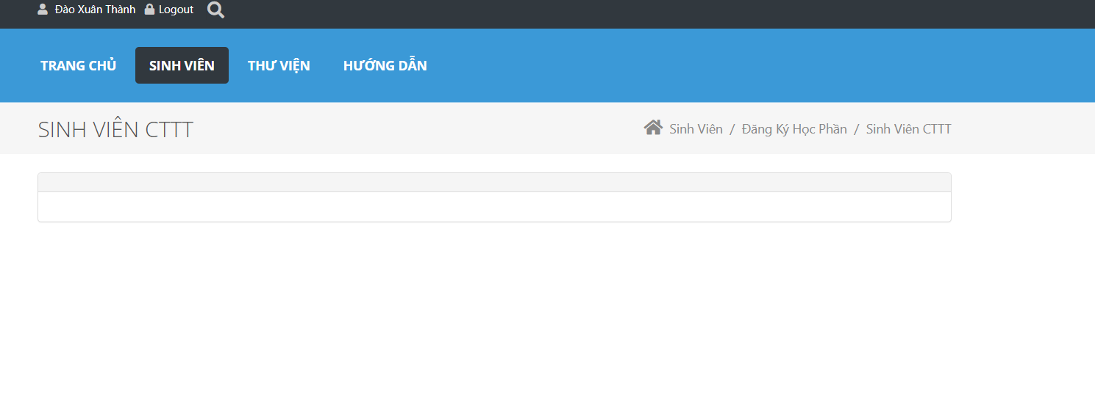

Slide 6

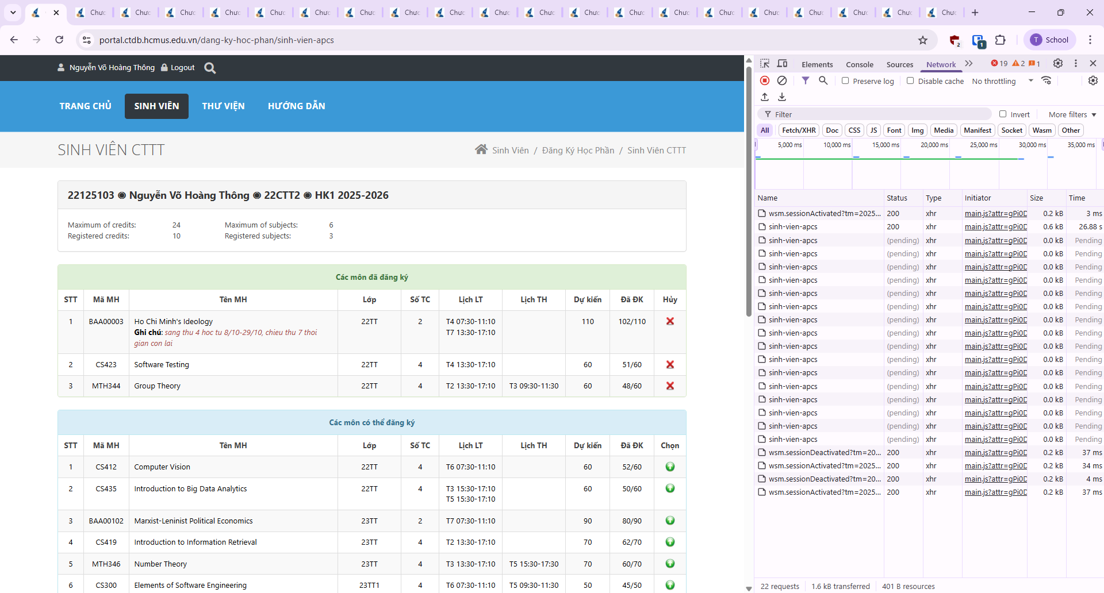
Refreshed so hard and got so far …

Slide 7



But in the end, the portal doesn’t respond…
Linkedin Pák

Slide 8
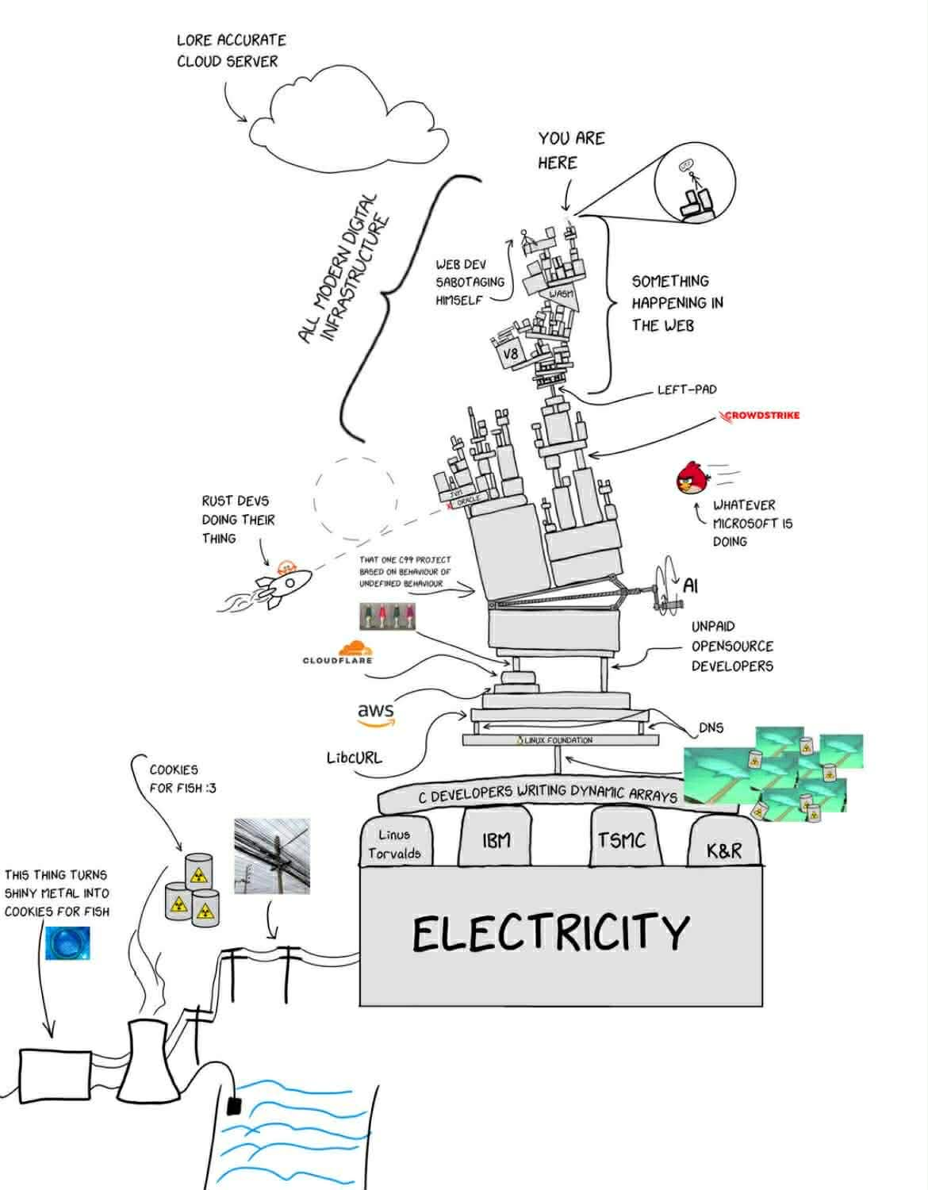
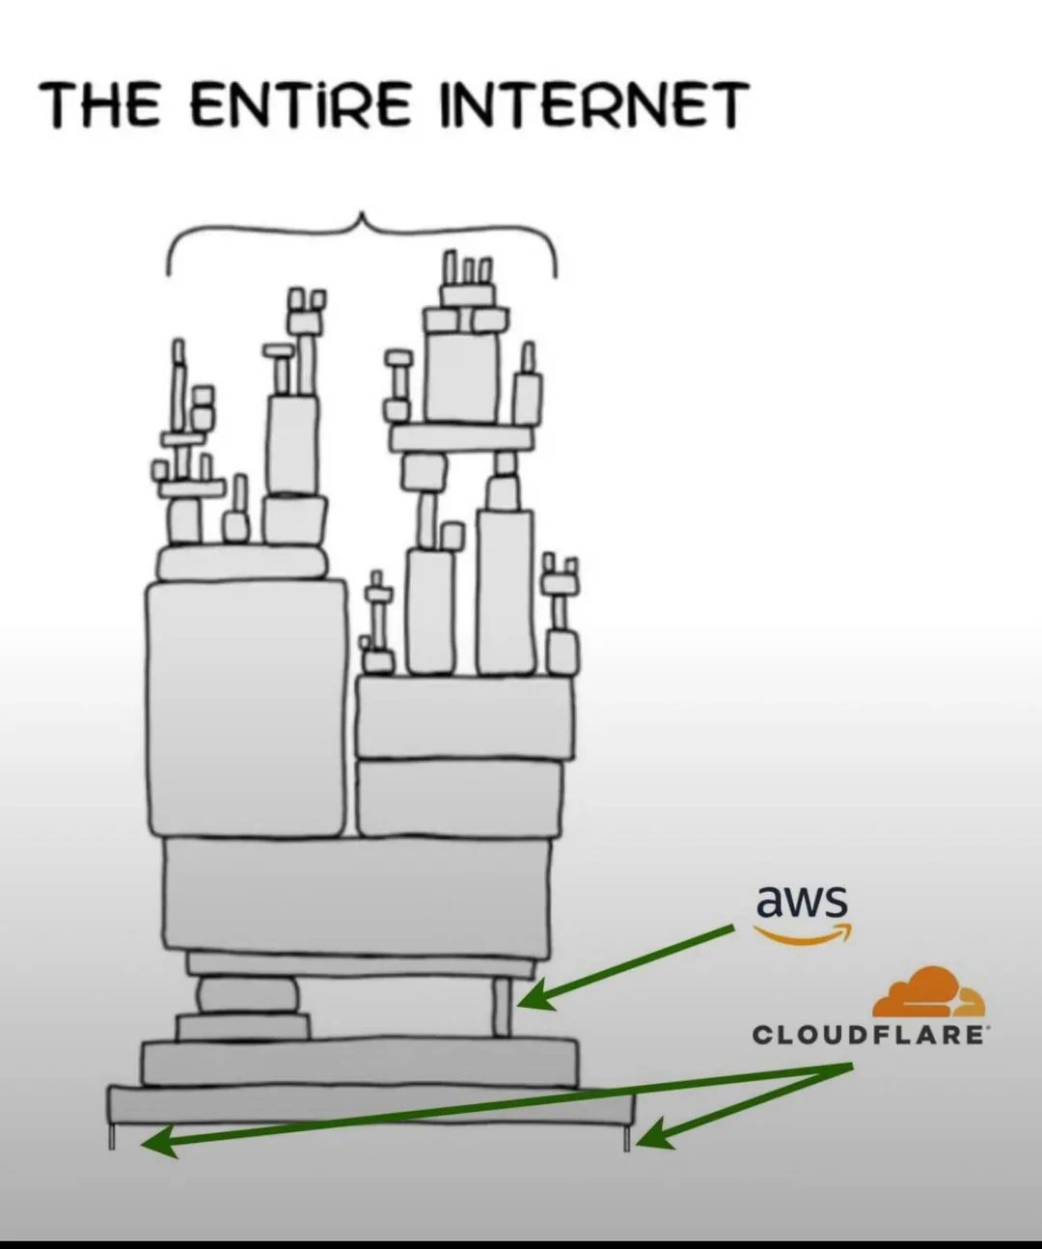

Nowadays…

Slide 9
WHY is "performance" important?
User experience: Slow response times increase drop-offs, reduce engagement, and erode trust; most users "abandon" an app if it takes more than a few seconds to load (Jakob Nielsen’s three response time limits*).
Scalability & cost: Efficient systems handle more users with fewer servers, lowering cloud bills and preventing outages during traffic spikes.
Business impact & reliability: Performance issues often manifest as downtime, bottlenecks, or cascading failures that directly affect revenue, SLAs (Service-Level Agreements), and reputation.
* https://www.nngroup.com/articles/response-times-3-important-limits/

Slide 10
02
The What
What is Performance Testing anyway?

Slide 11
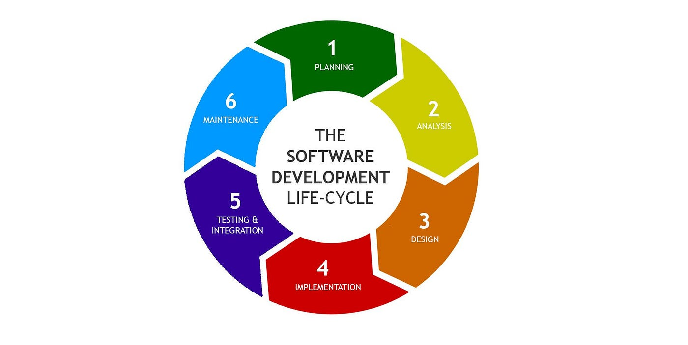
How to enforce "performance”?
* Image: https://medium.com/@artjoms/software-development-life-cycle-sdlc-6155dbfe3cbc

Slide 12
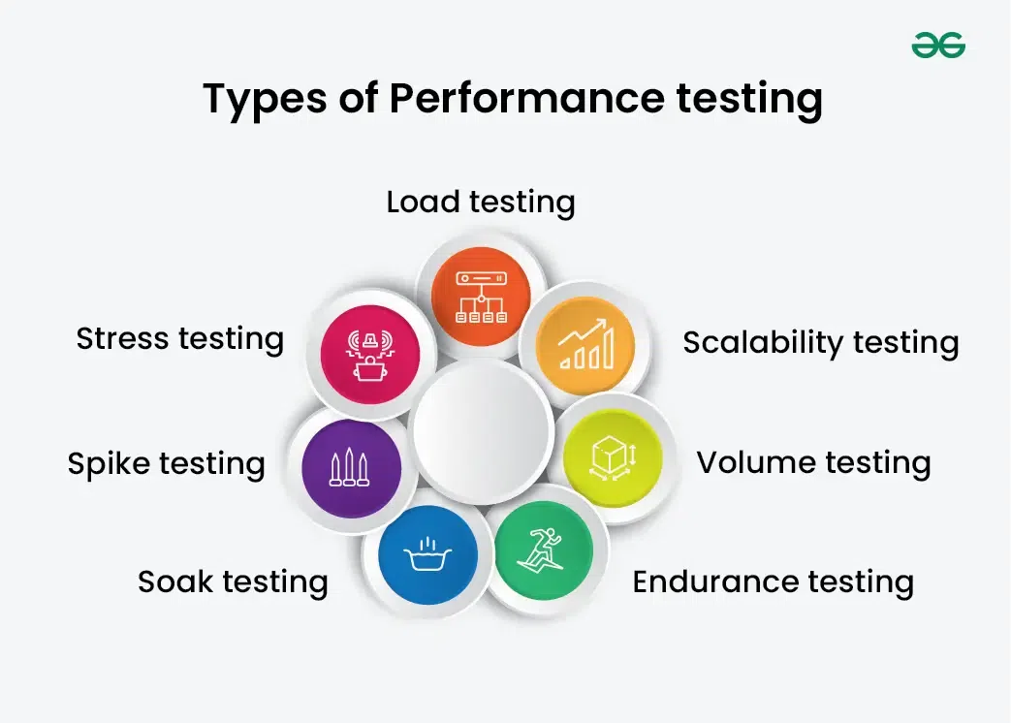
How to ensure "performance”?
* Image: https://www.geeksforgeeks.org/software-testing/performance-testing-software-testing/

Slide 13
Lesson review alert!!!

Slide 14
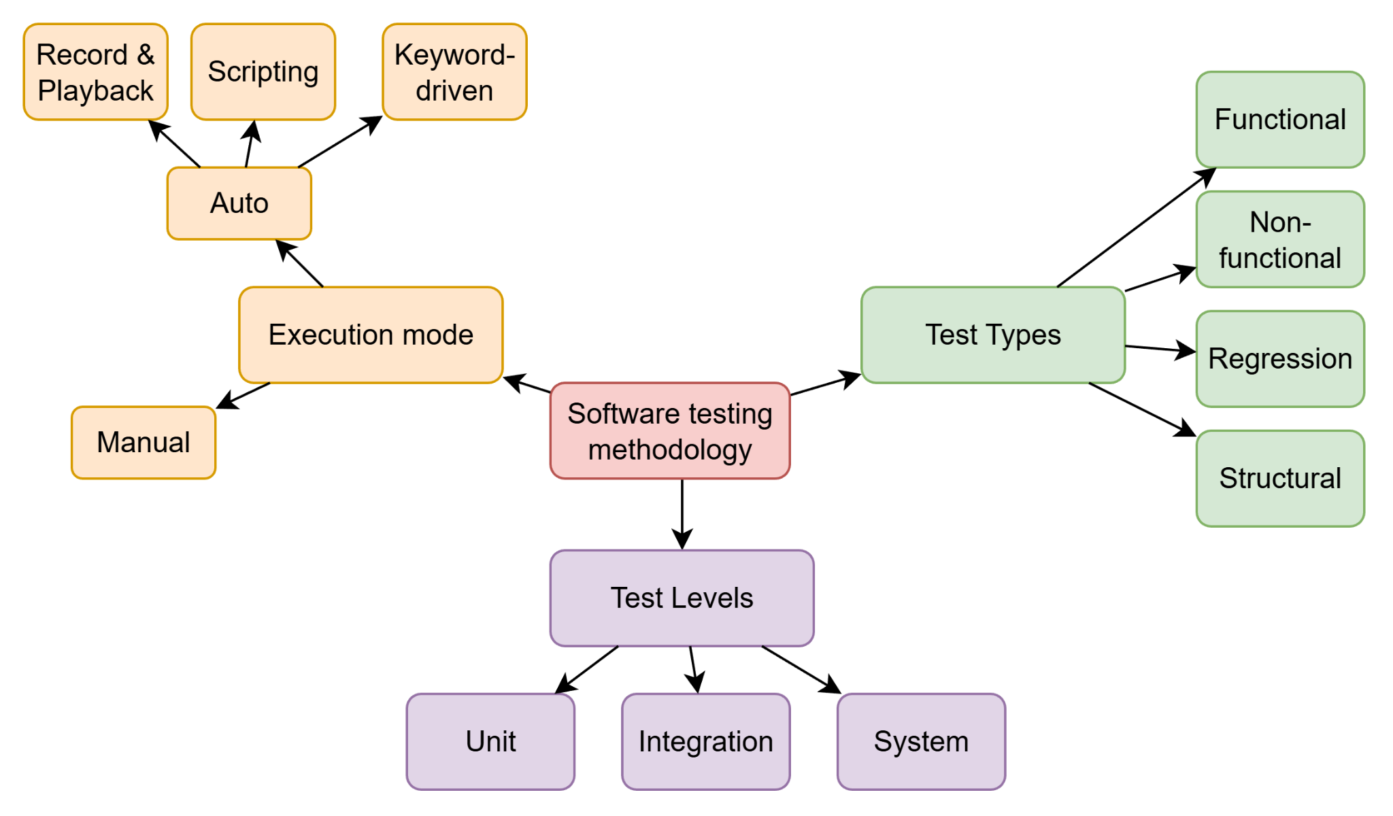
What is performance testing?

Slide 15
What is performance testing?
A type of non-functional testing measuring how a system performs under workload
Focus on responsiveness, stability, scalability, and resource usage
Goal: ensure the system meets performance expectations before release, not finding bugs

Slide 16
Key Concepts and Metrics
Term | Definition
Response Time | Time between request submission and response completion
Throughput | Number of transactions or requests handled per second.
Latency | Delay before a response begins
Bandwidth | The volume of data transferred per second
Concurrency | Number of simultaneous users or sessions
Error Rate | The percentage of requests resulting in errors
Resource Utilization | CPU, Memory, network, or I/O usage during test execution
Transactions Passed/Failed | Transactions Passed/Failed – the percentage of passed/failed transactions

Slide 17
Types of Performance Testing - WYSIWYG
Test Type | What It Evaluates | Example Scenario
Load Testing | System behavior under expected user load | Simulate 100 concurrent users performing normal actions
Stress Testing | System behavior beyond limits until failure | Ramp up to 10,000 users to find the breaking point
Spike Testing | Reaction to sudden, extreme increases in load | Simulate flash-sale traffic suddenly jumping from 50 → 5,000 users
Endurance (Soak) Testing | Stability over long time under steady load | Run a 24-hour continuous API workload to detect memory leaks
Volume Testing | Performance with large data sets (DB size, file size) | Test queries on a 100M-row database or process 10GB input files
Scalability Testing | How performance changes when resources scale | Increase traffic from 500 → 5,000 users while adding nodes to the cluster to check linear scaling

Slide 18
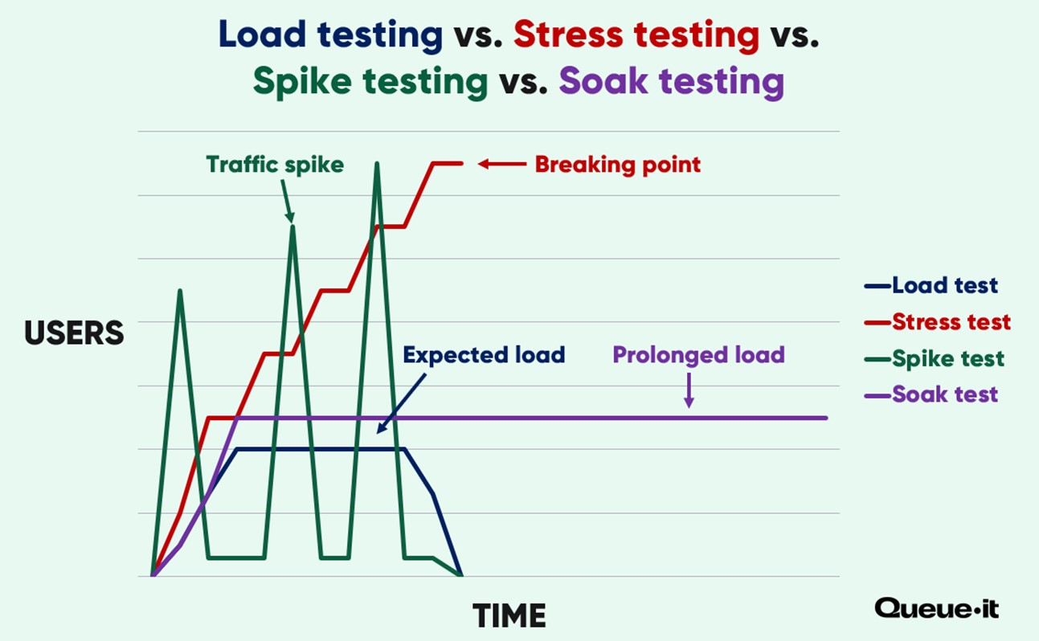
Types of Performance Testing
* Image: https://queue-it.com/blog/types-of-performance-testing/

Slide 19
Performance Testing Process
01
02
03
Identify test environment
Determine
performance criteria
Plan & design
04
05
06
07
Configure
test environment
Implement test design
Run tests
Analyze and
retest
* Adapted from Software Testing - CSC13003 - MOOC slides

Slide 20
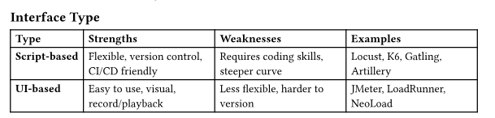
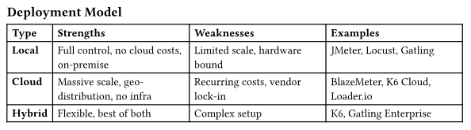
Performance Testing Tools

Slide 21
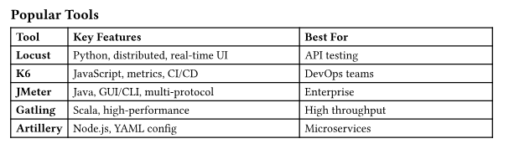
Performance Testing Tools

Slide 22
03
The How - Tools
How to perform performative performance testing?

Slide 23

Tool: Apache JMeter
100% Java open-source application for load and performance testing.
It simulates multiple users (threads) sending requests to a server and collects response metrics (latency, throughput, errors).

Slide 24
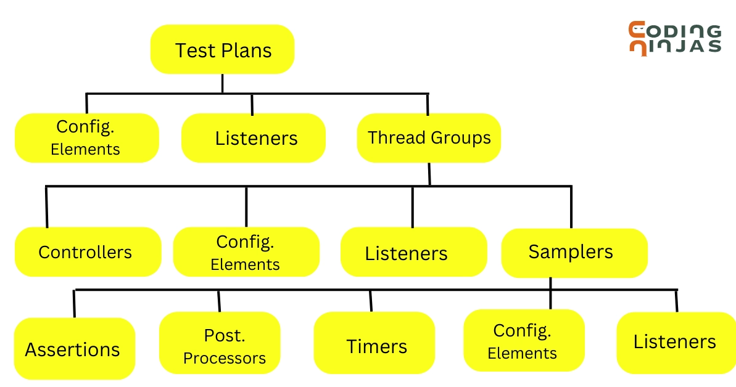
Tool: Apache JMeter

Slide 25
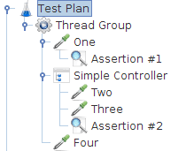
Tool: Apache JMeter

Slide 26

Tool: Locust
Lightweight Python-based load tester
Provides both a web UI for interactive runs and a headless mode for automated CI/CD pipelines.

Slide 27
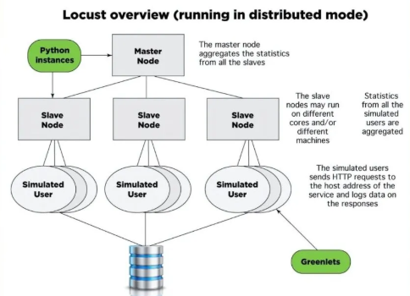
Tool: Locust

Slide 28
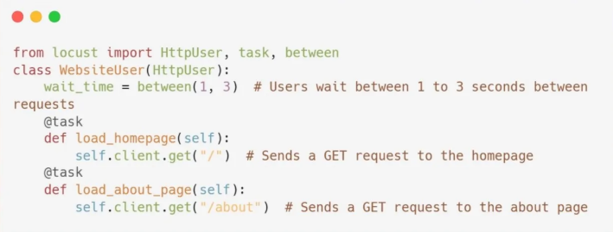
Tool: Locust

Slide 29
03
The How - Demo
How to perform performative performance testing?

Slide 30
Demo - JMeter
A start-up tool shop
There are 10 concurrent users per day on average
Black Friday came
~ 200 concurrent users check products
Expect the web page can respond in time and show correct content

Slide 31
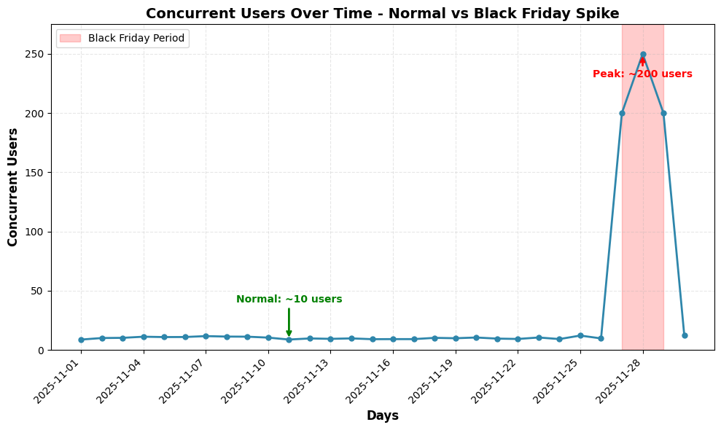

Slide 32
Demo - Locust
How to set up Locust locally
How to build a simple Locust load testing script
How to run Locust and see reported stats
Quick showcase of a more complicated set up
How to run Locust in headless mode

Slide 33
Demo - Locust - Simple example
Special variable
Event functions - How to access protected endpoints
How to make tasks
How to run Locust with web UI

Slide 34
Demo - Locust - complicated example
Multi-files set up
How to run in headless mode

Slide 35
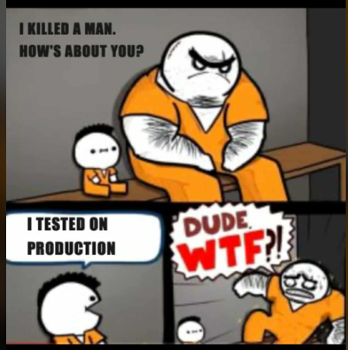
Thanks!
Do you have any questions?
Group 6
22125046 - Le Thanh Lam
22125076 - Nguyen Hoang Phuc
22125102 - Nguyen Chinh Thong
22125103 - Nguyen Vo Hoang Thong

